Slide 1

Maynooth University Postgraduate Student Survey
Gupta, Suchismit
Kumar Budhdeo, Pratik
O’Riogain, Sean
Weston, Megan

Slide 2

Brief
Conduct a survey with Maynooth University postgraduates (subset) to analyse workload satisfaction
Decide on a topic of interest
Design the survey questions
Collect student data based on the survey
Analyse and interpret the results using SAS

Slide 3
Approach
To investigate the factors affecting postgraduate students’ workload satisfaction
Survey peers in the following Degrees
Higher Diploma in Applied Computer Science
Masters in Data Science
Higher Diploma in Data Science
Masters in Software Development

Slide 4


Survey design
The survey questions included:
Weekly Lecture Attendance (%)
Hours spent per week on various listed activities
Rate satisfaction with current workload
Future plans within a year after finishing current programme

Slide 5
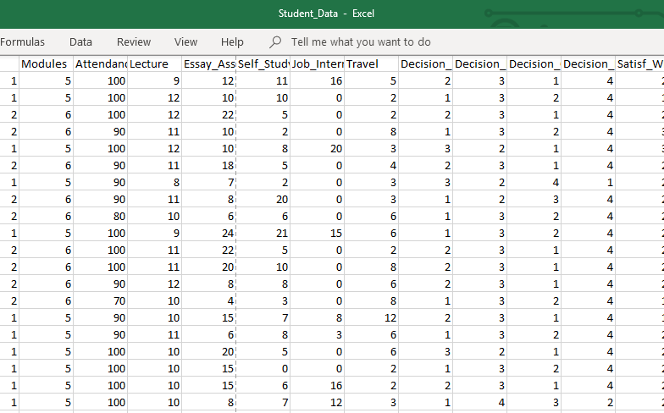
Data Collection
We surveyed 54 students from the chosen courses
Using Excel, we converted the responses to interpretable form
We read the data into SAS for analysis

Slide 6
Missing and Invalid Data
“NA” values were converted to missing
Gender Values were converted to Uppercase
Three observations had invalid Ranks
Corrected based on the most frequent sequence with Matching valid Ranks

Slide 7
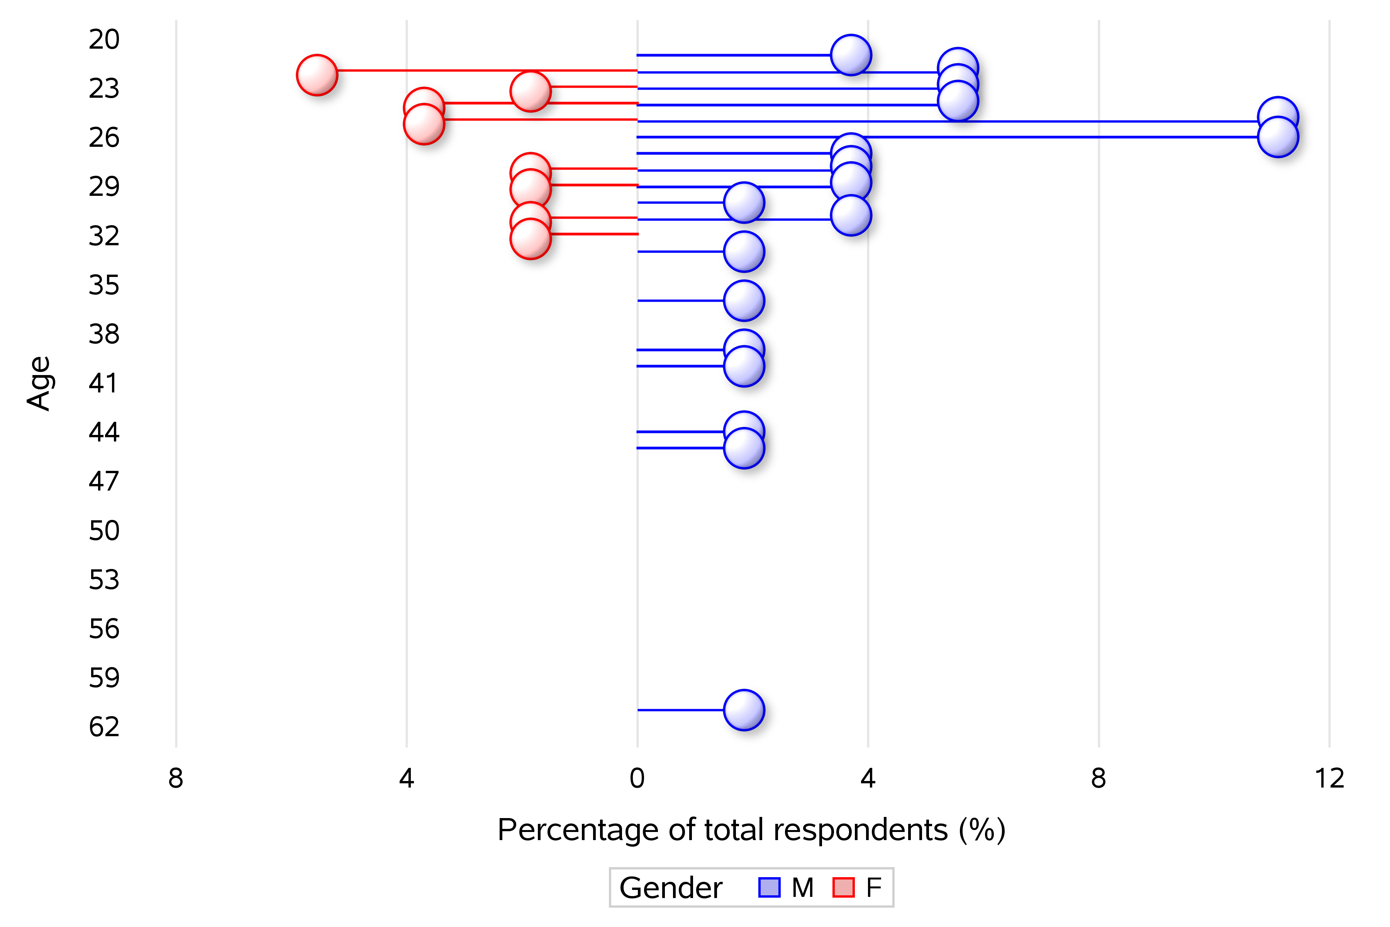
Data Analysis
Age and Gender Distribution (Lollipop)
3:1 Male: Female gender ratio
Wider spread in ages amongst male

Slide 8
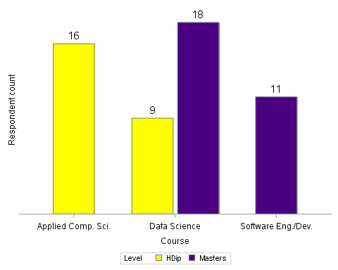
Course and Level
50% from Data Science, 30% from Applied Comp. Sci. and 20% from Software Eng./Dev.
Data Science was the only course with HDip and Masters students

Slide 9
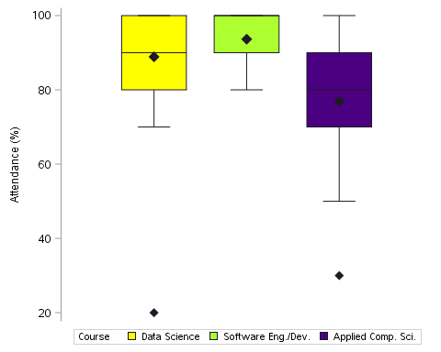
Attendance
67% of the respondents claim to have attended 90% or more of their lectures
Applied Computer Science has the largest spread and lowest mean of attendance values
Software Eng./Dev. have the highest mean attendance
Data Science have a left-skewed distribution with one low outlier

Slide 10
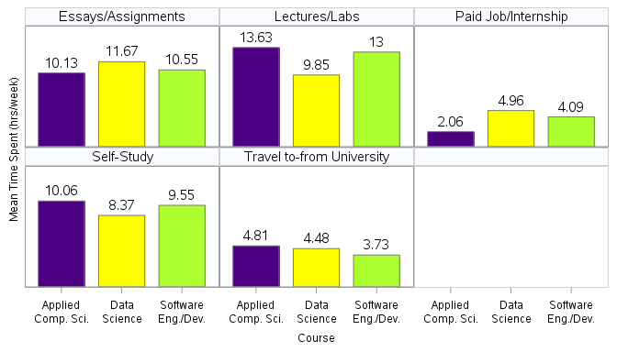
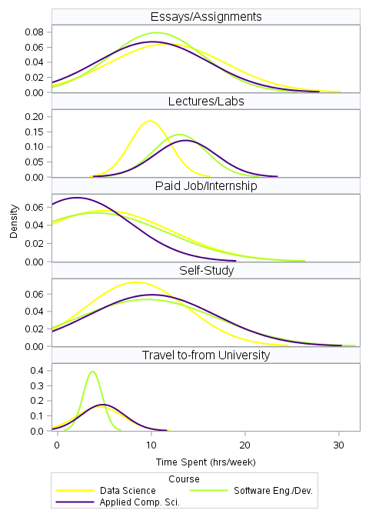
Time Spent
On average, Applied Computer Science spend the most time in lectures/labs and studying
Data Science spend the most mean time on essays/assignments
Most Applied Computer Science students spend little to no time at jobs/internships
Software Eng./Dev. Have the lowest average travel time

Slide 11
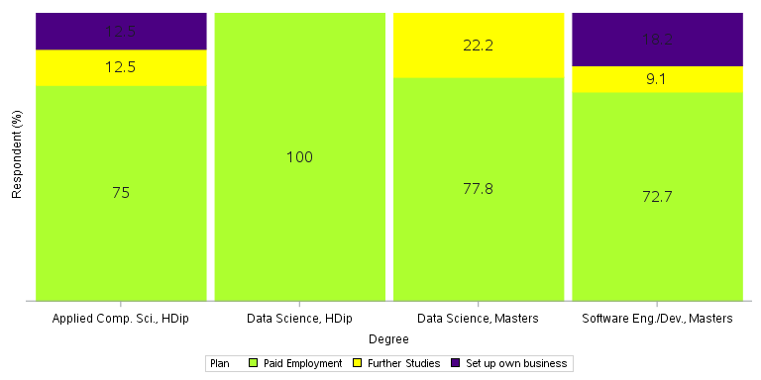
Future Plans
Overall
80% will seek paid employment after graduating
13% plan to go on to further education
Remainder are intent on setting up their own business
Nobody plans to travel
By degree
All respondents from the H. Dip. in Data Science intend to seek paid employment
All prospective entrepreneurs are in the Computer Science courses
Masters in Data Analytics had the highest proportion planning to go on to further education

Slide 12
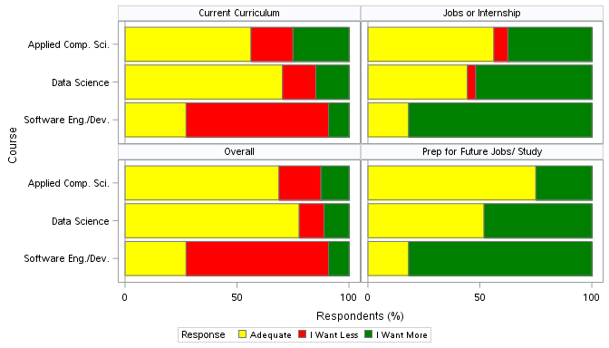
Workload Satisfaction
Software Eng./Dev. spend most time in lectures/labs and are most keen for a reduction in their workload and curriculum and most eager to do more job preparation
Data Science courses (both Masters and H. Dip.) have the highest overall satisfaction rate (both 78%) with their respective workload

Slide 13
Supervised Machine Learning
To investigate the influencing parameters of Workload Satisfaction
Random Forest
Constructs a multitude of decision trees during training
Outputs the modal class (classification) or mean prediction (regression) of individual trees
Loss Reduction Variable Importance ranks the predictors

Slide 14
Random Forest Findings
Module variable was highly correlated with Course, it was omitted from the model.
Other promising predictors such as time spent on Lectures/Labs, Essays/Assignments, etc. were found to be insignificant.
Degree Course and Age were among the top influencing factors.
Type | Top Influencing Factors | Least Influencing Factors
Current Curriculum | Age -> Level -> Course -> Gender -> Job | Assign -> Lecture -> Self Study -> Attendance -> Travel
Jobs or Internship | Level -> Age -> Course -> Gender -> Assign | Job -> Attendance -> Self Study -> Lecture -> Travel
Prep for Future Jobs/Study | Level -> Age -> Course -> Gender -> Assign | Job -> Self Study -> Lecture -> Attendance -> Travel
Overall | Course -> Level -> Gender -> Age -> Job | Assign -> Self Study -> Attendance -> Travel -> Lecture
Overall misclassification score and Mean Square Error calculated under the “Baseline Fit Statistics” of the fitted Random Forest model.
The model achieved classified majority of the sample correctly with 65% accuracy rate for overall workload.
Type | Misclassification | Avg. Sq. Error
Current Curriculum | 0.42 | 0.19
Jobs or Internship | 0.46 | 0.17
Prep for Future Jobs/Study | 0.48 | 0.25
Overall Workload | 0.35 | 0.17

Slide 15
Supervised Machine Learning
Random Forest is a non-parametric method and does not provide a statistical measure of significance
Multinomial Logistic Regression
To further examine the predictor-response relationship
It models nominal outcome variables
Log odds of the outcomes are modelled as a linear combination of the predictor variables

Slide 16
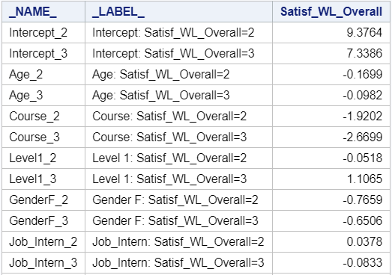

Logistic Regression Findings
We tested two models in this multinomial regression:
$Logit\left(\frac{Adequate}{I Want Less}\right)=β_{0}+β_{1}∗Age+β_{2}∗Course+β_{3}∗Level+β_{4}∗Gender+β_{5}∗Job_Intern$
$Logit\left(\frac{I Want More}{I Want Less}\right)=β_{0}′+β_{1}′∗Age+β_{2}′∗Course+β_{3}′∗Level+β_{4}′∗Gender+β_{5}′∗Job_Intern$
Adequate versus I Want Less (p <0.1)
Age, Course and Gender are significant
One-year increase in Age, we expect a 16.9% decrease in the odds of Adequate compared to I Want Less.
For female students, the relative log odds decreases by 76.6%
The relative log odds decreases by 1.92 moving from Applied Comp. Sci. to Software Eng./Dev. Most students from the Software Engineering course want less overall workload compared to the other two courses.
I Want More versus I Want Less (p<0.1)
Only the Course predictor is significant
The relative log odds decreases by 2.67 if moving from Applied Comp. Sci. to Software Eng./Dev.
This means that students from Applied Computer Science want more overall workload compared to other two courses

Slide 17
Conclusion
A survey was conducted on a subset of Maynooth University Postgraduates
Descriptive analysis was done is SAS
Findings were visualised using SAS
Supervised machine learning found that a combination of Age, Level, Course, Gender and Jobs were the most powerful predictors of student workload satisfaction
Lastly, we learned that paper-based surveys are difficult to conduct and care must be taken ensure good data quality during collection and data entry

